Slide 1
DKTES Textile and Engineering Institute, Ichalkaranji. Final Year B. Tech. (Semester – VII) Artificial Intelligence & Data Science ADL405: TIME SERIES ANALYSIS AND FORECASTING
Teaching Scheme: Lectures: 03 Hrs. /Week Credits 03
Evaluation Scheme:
MSE: 30 Marks
ISE: 20 Marks
SEE: 50 Marks

Slide 2
Course Outcomes:
On completion of the course, student will be able to–
1.Explain the fundamentals of time series analysis and forecasting methods
2.Illustrate the regression analysis and forecasting in time series analysis
3.Explain the exponential smoothing methods and ARIMA models
4.Describe the transfer functions and intervention models

Slide 3
Unit I - INTRODUCTION TO FORECASTING

Slide 4
THE NATURE AND USES OF FORECASTS
A forecast is a prediction of some future event or events.
Forecasting is an important problem that spans many fields including business and industry, government, economics, environmental sciences, medicine, social science, politics, and finance.
Forecasting problems are often classified as short-term, medium-term, and long-term
Short-term forecasting problems involve predicting events only a few time periods (days, weeks, and months) into the future.
Medium-term forecasts extend from 1 to 2 years into the future, and
long-term forecasting problems can extend beyond that by many years.

Slide 5
Short- and medium-term forecasts are required for activities that range from operations management to budgeting and selecting new research and development projects.
Short- and medium-term forecasting is typically based on identifying, modeling, and extrapolating the patterns found in historical data.
Long-term forecasts impact issues such as strategic planning.

Slide 6
Most forecasting problems involve the use of time series data.
A time series is a time-oriented or chronological sequence of observations on a variable of interest.
What is a Time Series?
A time series is a sequence of data points collected, recorded, or measured at successive, evenly-spaced time intervals.
Each data point represents observations or measurements taken over time, such as stock prices, temperature readings, or sales figures.

Slide 7
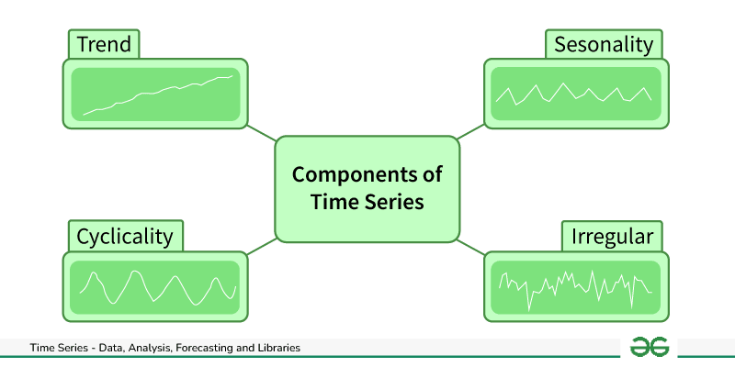
Components of Time Series Data
Trend: Trend represents the long-term movement or directionality of the data over time. It captures the overall tendency of the series to increase, decrease, or remain stable.
Seasonality: Seasonality refers to periodic fluctuations or patterns that occur at regular intervals within the time series.

Slide 8
Cyclic variations: Cyclical variations are longer-term fluctuations in the time series that do not have a fixed period like seasonality.
Irregularity (or Noise): Irregularity, also known as noise or randomness, refers to the unpredictable or random fluctuations in the data that cannot be attributed to the trend, seasonality, or cyclical variations.

Slide 9
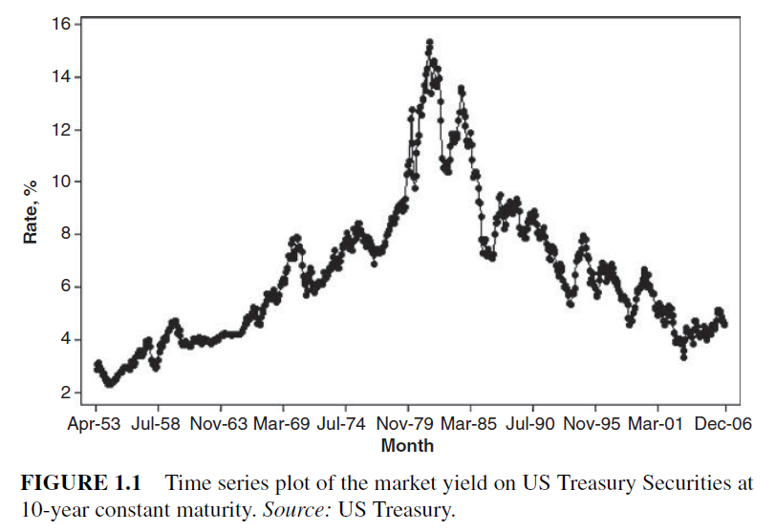
Time series plot

Slide 10
Forecasting application to areas
The reason that forecasting is so important is that prediction of future events is a critical input into many types of planning and decision-making processes, with application to areas such as the following:
Operations Management.
Business organizations routinely use forecasts of product sales or demand for services in order to schedule production, control inventories, manage the supply chain, determine staffing requirements, and plan capacity
Notes:
Operations Management. Business organizations routinely use forecasts of product sales or demand for services in order to schedule production, control inventories, manage the supply chain, determine staffing requirements, and plan capacity. Forecasts may also be used to determine the mix of products or services to be offered and the locations at which products are to be produced.

Slide 11
2. Marketing.
Forecasting is important in many marketing decisions. Forecasts of sales response to advertising expenditures, new promotions, or changes in pricing polices enable businesses to evaluate their effectiveness, determine whether goals are being met, and make adjustments.
Notes:
Marketing. Forecasting is important in many marketing decisions. Forecasts of sales response to advertising expenditures, new promotions, or changes in pricing polices enable businesses to evaluate their effectiveness, determine whether goals are being met, and make adjustments.

Slide 12
3. Finance and Risk Management.
Investors in financial assets are interested in forecasting the returns from their investments.
These assets include but are not limited to stocks, bonds, and commodities; other investment decisions can be made relative to forecasts of interest rates, options, and currency exchange rates.
Notes:
Finance and Risk Management. Investors in financial assets are interested
in forecasting the returns from their investments. These assets
include but are not limited to stocks, bonds, and commodities; other
investment decisions can be made relative to forecasts of interest
rates, options, and currency exchange rates. Financial risk management
requires forecasts of the volatility of asset returns so that
the risks associated with investment portfolios can be evaluated and
insured, and so that financial derivatives can be properly priced

Slide 13
4. Economics.
Governments, financial institutions, and policy organizations require forecasts of major economic variables, such as gross domestic product, population growth, unemployment, interest rates, inflation, job growth, production, and consumption.
These forecasts are an integral part of the guidance behind monetary and fiscal policy, and budgeting plans and decisions made by governments.
Notes:
Economics. Governments, financial institutions, and policy organizations
require forecasts of major economic variables, such as gross
domestic product, population growth, unemployment, interest rates,
inflation, job growth, production, and consumption. These forecasts
are an integral part of the guidance behind monetary and fiscal policy,
and budgeting plans and decisions made by governments. They
are also instrumental in the strategic planning decisions made by
business organizations and financial institutions.

Slide 14
5. Industrial Process Control.
Forecasts of the future values of critical quality characteristics of a production process can help determine when important controllable variables in the process should be changed, or if the process should be shut down and overhauled.
6. Demography.
Forecasts of population by country and regions are made routinely, often stratified by variables such as gender, age, and race. Demographers also forecast births, deaths, and migration patterns of populations.
Notes:
5. Industrial Process Control. Forecasts of the future values of critical
quality characteristics of a production process can help determine
when important controllable variables in the process should be
changed, or if the process should be shut down and overhauled. Feedback
and feedforward control schemes are widely used in monitoring
and adjustment of industrial processes, and predictions of the process
output are an integral part of these schemes.
6. Demography. Forecasts of population by country and regions are
made routinely, often stratified by variables such as gender, age,
and race. Demographers also forecast births, deaths, and migration
patterns of populations.Governments use these forecasts for planning
policy and social service actions, such as spending on health care,
retirement programs, and antipoverty programs. Many businesses
use forecasts of populations by age groups to make strategic plans
regarding developing new product lines or the types of services that
will be offered.

Slide 15
Types of forecasting techniques
There are only two broad types of forecasting techniques—
Qualitative methods and
Quantitative methods.

Slide 16
Qualitative forecasting techniques
1. Qualitative forecasting techniques are often subjective in nature and require judgment on the part of experts.
Qualitative forecasts are often used in situations where there is little or no historical data on which to base the forecast.
An example would be the introduction of a new product, for which there is no relevant history.

Slide 17
Qualitative forecasting techniques
Sometimes qualitative forecasting methods make use of marketing tests, surveys of potential customers, and experience with the sales performance of other products (both their own and those of competitors).
Used for forecast is subjective judgment.
Market research: Polling a large number of people on a specific product or service to predict how many people will buy or use it once launched.
Delphi method: Asking field experts for general opinions and then compiling them into a forecast.
Notes:
Qualitative forecasting techniques are often subjective in nature and
require judgment on the part of experts. Qualitative forecasts are often
used in situations where there is little or no historical data on which to base
the forecast. An example would be the introduction of a new product, for
which there is no relevant history. In this situation, the company might use
the expert opinion of sales andmarketing personnel to subjectively estimate
product sales during the new product introduction phase of its life cycle.
Sometimes qualitative forecasting methods make use of marketing tests,
surveys of potential customers, and experience with the sales performance
of other products (both their own and those of competitors). However,
although some data analysis may be performed, the basis of the forecast is
subjective judgment.
Perhaps the most formal and widely known qualitative forecasting technique
is the Delphi Method. This technique was developed by the RAND
Corporation (see Dalkey [1967]). It employs a panel of experts who are
assumed to be knowledgeable about the problem. The panel members are
physically separated to avoid their deliberations being impacted either by
social pressures or by a single dominant individual. Each panel member
responds to a questionnaire containing a series of questions and returns the
information to a coordinator.

Slide 18
Quantitative forecasting techniques
Quantitative forecasting techniques make formal use of historical data and a forecasting model.
The model formally summarizes patterns in the data and expresses a statistical relationship between previous and current values of the variable.
Then the model is used to project the patterns in the data into the future.

Slide 19
Quantitative forecasting techniques
There are several types of forecasting models in general use. The three most widely used are regression models, smoothing models, and general time series models.
Regression models make use of relationships between the variable of interest and one or more related predictor variables.
Sometimes regression models are called causal forecasting models, because the predictor variables are assumed to describe the forces that cause or drive the observed values of the variable of interest.
An example would be using data on house purchases as a predictor variable to forecast furniture sales.
Smoothing models typically employ a simple function of previous observations to provide a forecast of the variable of interest.

Slide 20
Forecast terms
point estimate or point forecast.
Forecast as a single number that represents our best estimate of the future value of the variable of interest.
prediction interval (PI)
The PI is a range of values for the future observation, and it is likely to prove far more useful in decision-making than a single number.
Forecast horizon and the forecast interval.
The forecast horizon is the number of future periods for which forecasts must be produced. The horizon is often dictated by the nature of the problem.
The forecast horizon is also often called the forecast lead time.
For example, in production planning, forecasts of product demand may be made on a monthly basis.

Slide 21
Forecast terms
The forecast interval is the frequency with which new forecasts are prepared
For example, in production planning, we might forecast demand on a monthly basis, for up to 3 months in the future.
If the forecast lead time is always the same length, say, T periods, and the forecast is revised each time period, then we are employing a rolling or moving horizon forecasting approach.
This system updates or revises the forecasts for T−1 of the periods in the horizon and computes a forecast for the newest period T.

Slide 22
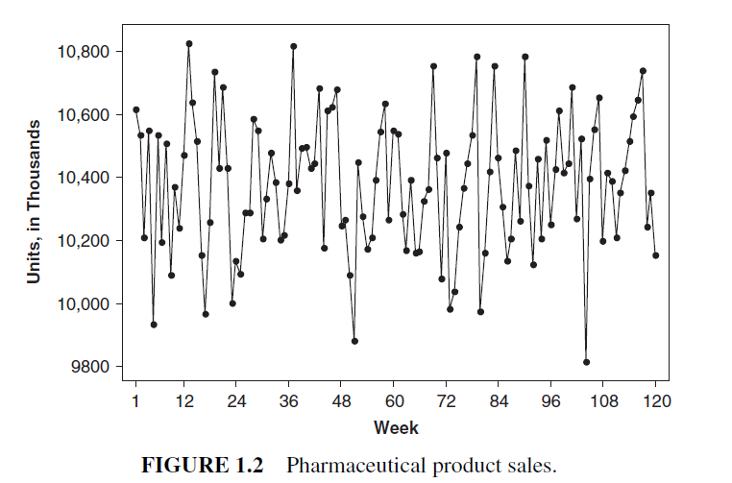
SOME EXAMPLES OF TIME SERIES
Time series plots can reveal patterns such as random, trends, level shifts, periods or cycles, unusual observations, or a combination of patterns.
The sales of a mature pharmaceutical product may remain relatively flat in the absence of unchanged marketing or manufacturing strategies.
Weekly sales of a generic pharmaceutical product shown in Figure 1.2
appear to be constant over time, at about 10,400 × 10^3 units, in a random sequence with no obvious patterns.
Notes:
Time series plots can reveal patterns such as random, trends, level shifts,
periods or cycles, unusual observations, or a combination of patterns. Patterns
commonly found in time series data are discussed next with examples
of situations that drive the patterns.
The sales of a mature pharmaceutical product may remain relatively
flat in the absence of unchanged marketing or manufacturing strategies.
Weekly sales of a generic pharmaceutical product shown in Figure 1.2
appear to be constant over time, at about 10,400 × 103 units, in a random
sequence with no obvious patterns (data in Appendix B, Table B.2).
To assure conformance with customer requirements and product specifications,
the production of chemicals is monitored by many characteristics.
These may be input variables such as temperature and flow rate, and output
properties such as viscosity and purity.
Due to the continuous nature of chemical manufacturing processes,
output properties often are positively autocorrelated; that is, a value
above the long-run average tends to be followed by other values above the average, while a value below the average tends to be followed by other
values below the average.

Slide 23
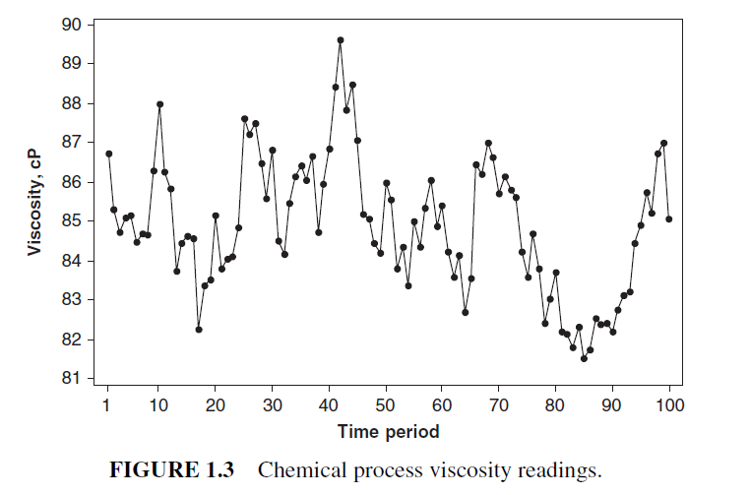
The viscosity readings plotted in Figure 1.3 exhibit autocorrelated behavior, tending to a long-run average of about 85 centipoises (cP), but with a structured, not completely random, appearance
Notes:
The USDA National Agricultural Statistics Service publishes agricultural
statistics for many commodities, including the annual production of
dairy products such as butter, cheese, ice cream, milk, yogurt, and whey.
These statistics are used for market analysis and intelligence, economic
indicators, and identification of emerging issues.
Blue and gorgonzola cheese is one of 32 categories of cheese for which
data are published. The annual US production of blue and gorgonzola
cheeses (in 103 lb) is shown in Figure 1.4 (data in Appendix B, Table
B.4). Production quadrupled from 1950 to 1997, and the linear trend has
a constant positive slope with random, year-to-year variation.
The US Census Bureau publishes historic statistics on manufacturers’
shipments, inventories, and orders. The statistics are based on North American
Industry Classification System (NAICS) code and are utilized for purposes
such as measuring productivity and analyzing relationships between
employment and manufacturing output.

Slide 24
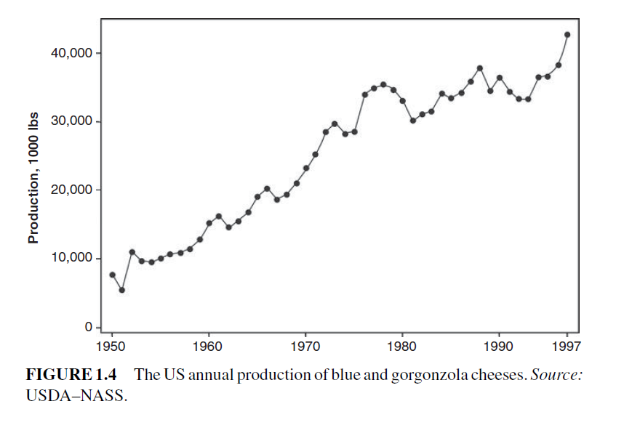
The annual US production of blue and gorgonzola
cheeses (in 10^3lbs) is shown in Figure 1.4

Slide 25
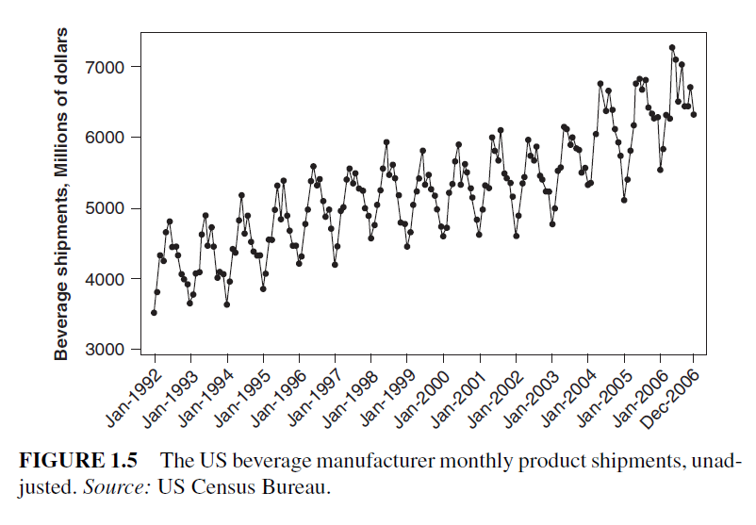
The plot of monthly beverage product shipments
(Figure 1.5) reveals an overall increasing trend, with a distinct cyclic pattern that is repeated within each year.

Slide 26
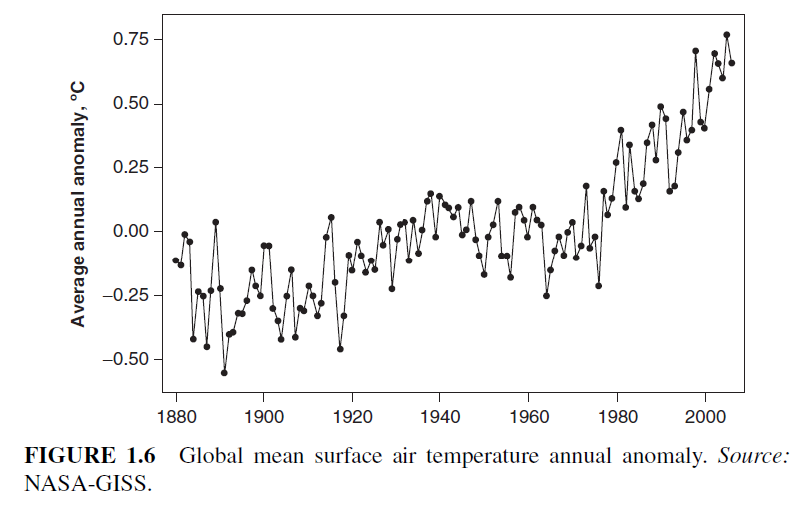
The plot of the annual mean anomaly in global surface air temperature
(Figure 1.6) shows an increasing trend since 1880; however, the slope, or rate of change, varies with time periods

Slide 27
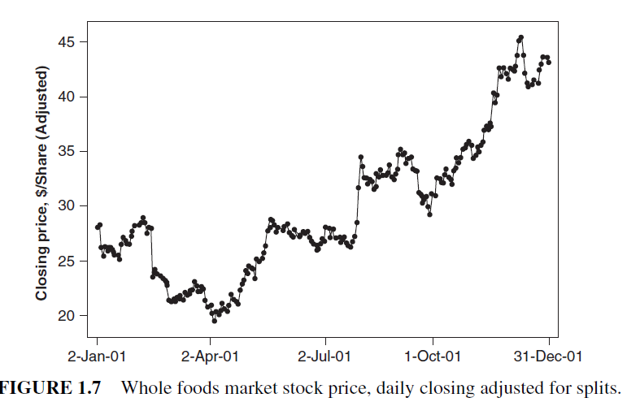
Business data such as stock prices and interest rates often exhibit nonstationary behavior; that is, the time series has no natural mean.
The daily closing price adjusted for stock splits of Whole Foods Market (WFMI)
stock in 2001 (Figure 1.7) exhibits a combination of patterns for both mean level and slope

Slide 28
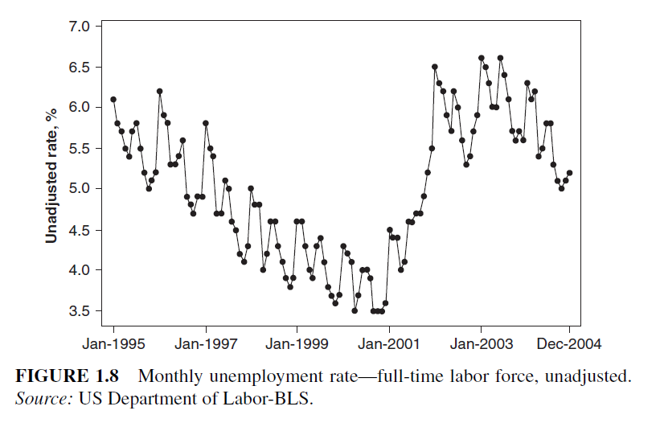
The plot of monthly unadjusted unemployment rates (Figure 1.8)
exhibits a mixture of patterns, similar to Figure 1.5

Slide 29
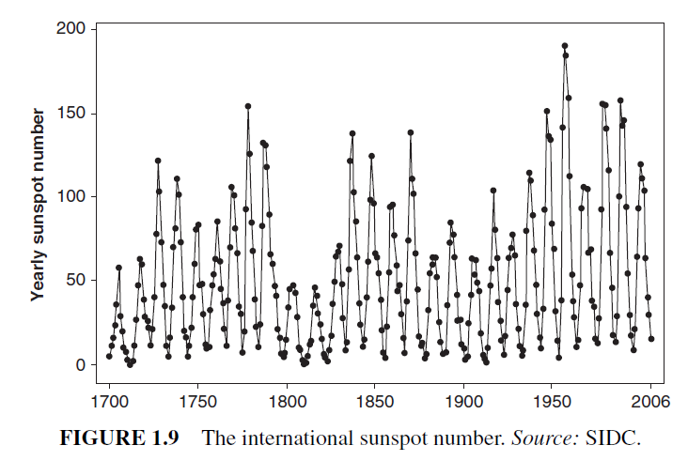
In Figure 1.9, the plot of annual sunspot numbers reveals cyclic patterns of varying magnitudes

Slide 30
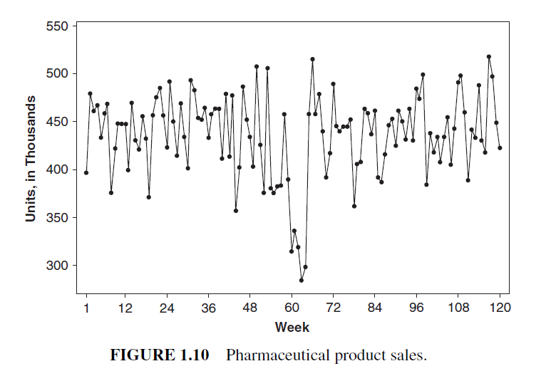
Weekly sales of a generic pharmaceutical product dropped due to limited availability resulting from a fire at one of the four production facilities.
The 5-week reduction is apparent in the time series plot of weekly sales shown in Figure 1.10

Slide 31
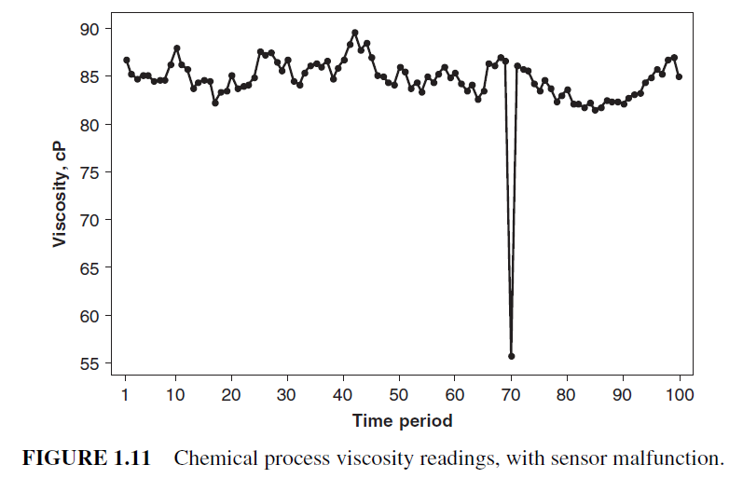
Another type of unusual event may be the failure of the data measurement or collection system. After recording a vastly different viscosity reading at time period 70 (Figure 1.11), the measurement system was checked with a standard and determined to be out of calibration. The cause
was determined to be a malfunctioning sensor

